Slide 1
HMT 801 Travel Agency and Tour Operations
UNIT 5
Travel Bodies and Association
Topic
History, aims and role of IATO and ITDC
Course Outcome (CO)
CO5: Evaluate the Sustainability of Travel operations and activities of travel bodies and associations

Slide 2
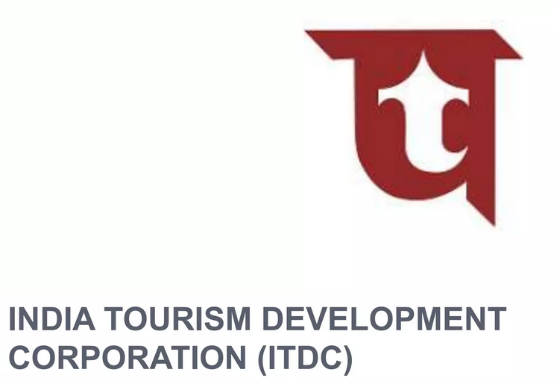

Slide 3
Historical background
1963: L K Jha committee constituted
1965: On L K Jha committee recommendations 3 corporations
Hotel Corporation of India Ltd
India Tourism Corporation Ltd
India Tourism Transport undertaking
1966: Merged 3 of them and made ITDC

Slide 4
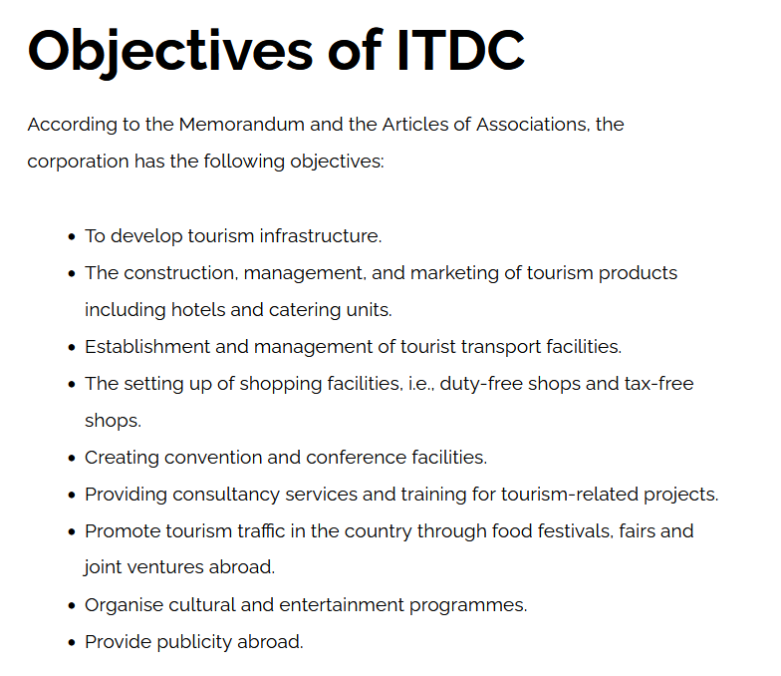

Slide 5
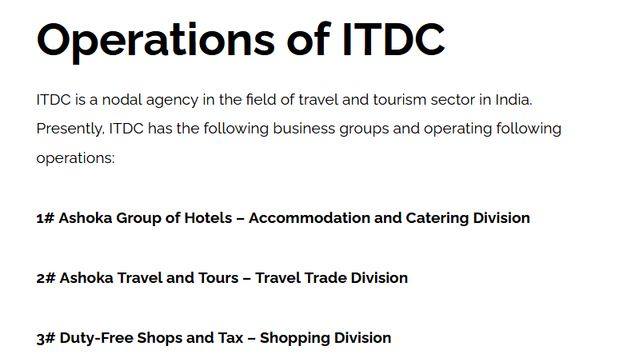

Slide 6
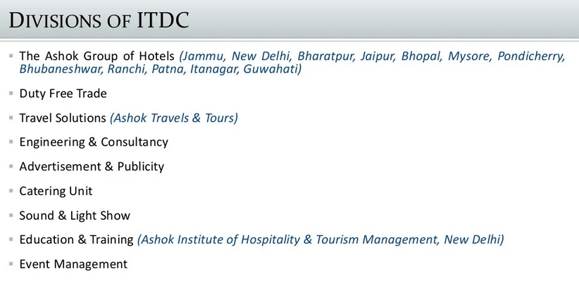

Slide 7
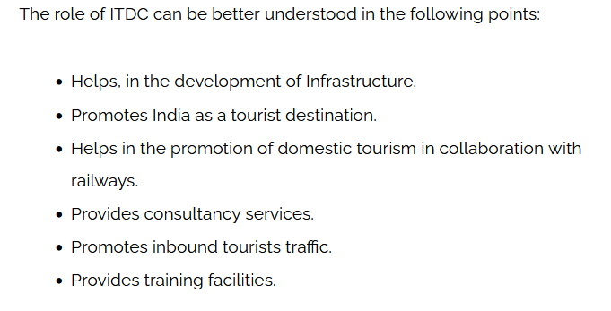

Slide 8
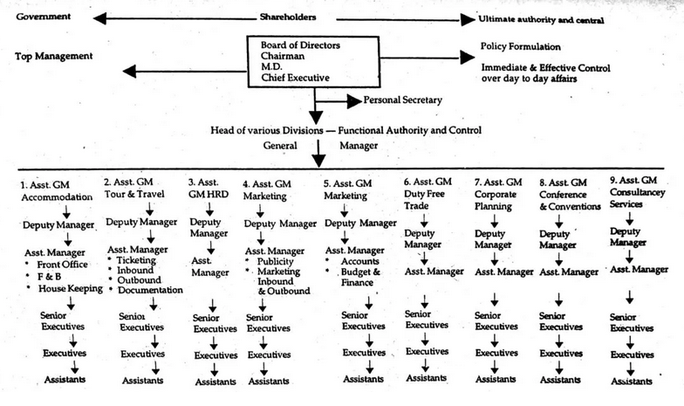
Organizational structure

Slide 9
IATO – Indian Association of Tour Operators
Indian Association of Tour Operators (IATO):- Over the year the functions of the travel companies have increased considerably.
They are specialized in one product line i.e. tour packaging. Today, they are the manufacturers of tourism product and are commonly known as ‘tour operators‘.

Slide 10
to encourage, assist and to protect the interests of tour operators, the Indian Association of Tour Operators (IATO) was formed in 1982.
IATO was established in 1982 at the national capital Delhi. The association is the representative body of tour operators.

Slide 11
Objectives and Aims of IATO
To promote national integration, international welfare, and goodwill.
To take necessary steps in the promotion, encouragements, and development of tourism in the country.
To develop, promote and encourage friendly feelings among the tour operators and travel agents/agencies.
To protect the interest of the members.
To set up and maintain high ethical standards.
To settle the disputes of the members.

Slide 12
To communicate and negotiate with chambers of commerce, IATA, DoT, Ministry of Tourism, and other organizations in other countries.
To organize the promotional tour with DoT, Airlines, and International Tourism bodies.
To institute awards for excellence in the travel trade.
To assist students with the scholarship to pursue higher education or research for the development of tourism.
To undertake such welfare activities as the members cannot take individually.
To print and publish information material for the benefit of members.

Slide 13
IATO Membership
Active Members
Associated Members
Allied Members
Honorary Members
International Members

Slide 14
Role and Functions of IATO
Promote national integration and international understanding.
Acts as an image builder.
Organizes ‘Farm Tour’ (overseas).
Encourage tourism education and research.
Settle disputes between the members.
Protect the members from the mal-practices.
Provides information

Slide 15


